Slide 1


General Biology lab
Al-Karkh University for Science
Collage of Science
Microbiology Department
Dr. Rawa Abdul Redha Aziz
Ph.D Antibiotics/ Molecular biology
Laboratory Staff:
1. Lecturer Dr. Rawa Abdul Redha Aziz
2. L. assistant Sura Alaa Saud
3. L. assistant Gada Readh
Supervised by:
1. Prof. Munira Ch. Ismaeel
2. Ass. Prof. Israa AJ Ibrahim

Slide 2
Lab 5: Wet mounts slide method
This method is used to examine the bacterial cell at natural state , especially when studying special characteristics like bacterial motility.
It also aids in observation of fungal spores, supporting structures, and hyphae.
This test is most useful for examining of motile trophozoites or helminth larvae or ova. A small amount of stool is mixed with a drop of 0.85% saline or Lugols Iodine and covered with a coverslip.

Slide 3
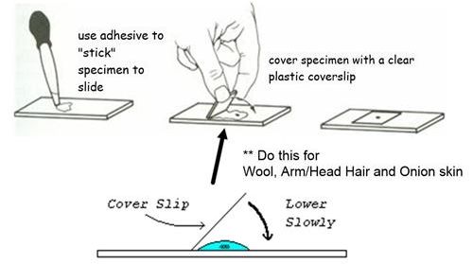
Procedure: (Figure 1)
Figure 1: Wet mount slide procedure

Slide 4
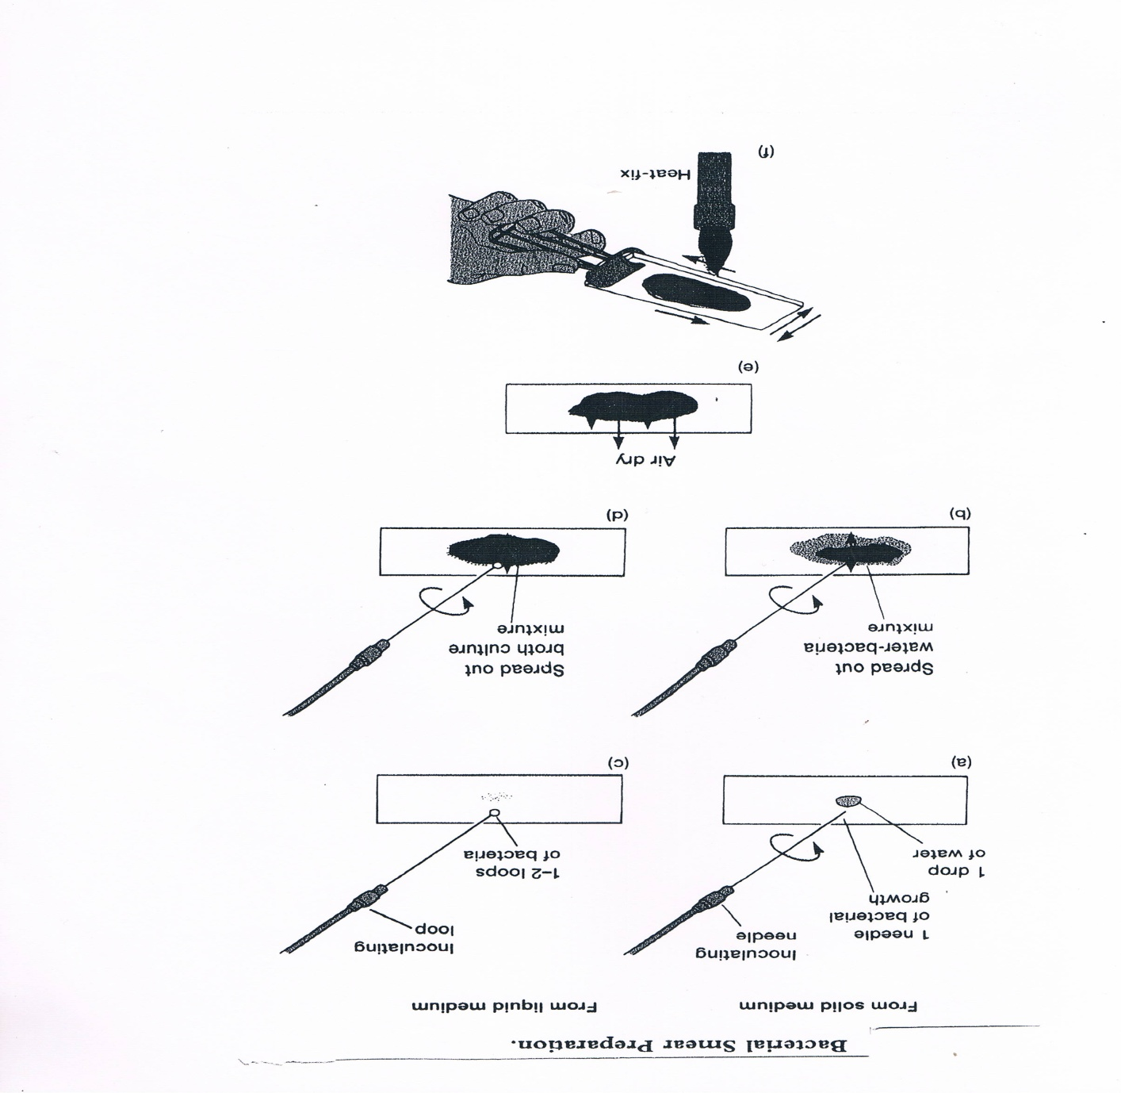
Figure 2: Bacterial smear presentation

